Slide 1

CSE413 – Security of Information Systems 2020 PhD Furkan Gözükara, Toros University https://github.com/FurkanGozukara/Security-of-Information-Systems-CSE413-2020
Lecture 4
Cryptography – Part 2
Composed from Prof. Audun Jøsang, University of Oslo, Information Security 2018 Lectures
Source : https://www.uio.no/studier/emner/matnat/ifi/INF3510/v18/lectures/

Slide 2
MAC and MAC algorithms
MAC means two things:
The computed message authentication code h(M, k).
General name for algorithms used to compute a MAC.
In practice, the MAC algorithm is e.g.
HMAC (Hash-based MAC algorithm)).
CBC-MAC (CBC based MAC algorithm).
CMAC (Cipher-based MAC algorithm).
MAC algorithms, a.k.a. keyed hash functions, support data origin authentication services.

Slide 3




Practical message integrity with MAC
h(M,K)
MAC
MAC sent together with message M
Verify h(M,K) = h(M ’,K)
MAC
h(M ’ ,K)
MAC
function
MAC
function
Shared secret key
Shared secret key
Alice
Message M
Received message M’
Bob

Slide 4
HMAC
Define: ipad = 3636….36 (512 bit)
opad = 5C5C…5C (512 bit)
⊕ = XOR
HMAC_{K}(x) = SHA-1((K ⊕ opad) || SHA-1((K ⊕ ipad) || x ))
opad
K
ipad
x
SHA-2
SHA-2
HMAC

Slide 5

CBC-MAC
CBC-MAC(x, K)
set x = x₁ || x₂ || …. || x_{n}
IV ← 00 … 0
y₀ ← IV
for i ← 1 to n
do y_{i} ← e_{K}(y_{i-1} ⊕ x_{i})
return (y_{n})
x₁
x₂
x_{n}
e_{K}
e_{K}
e_{K}

Slide 6
Public-Key Cryptography

Slide 7
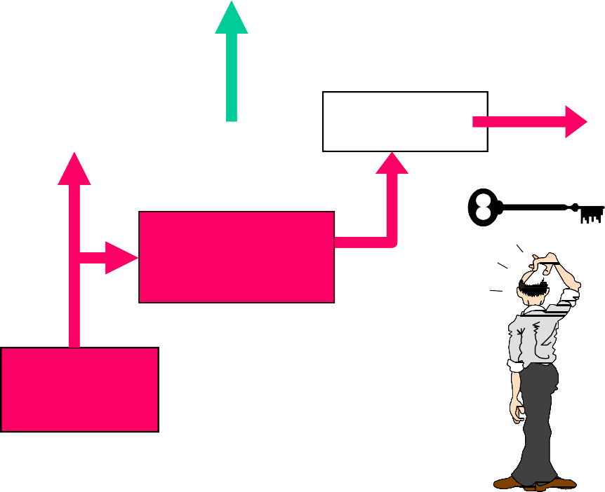


Symmetric cryptosystem
Oscar
Alice
Encryptor
Decryptor
Bob
Secure channel
Key source

Slide 8
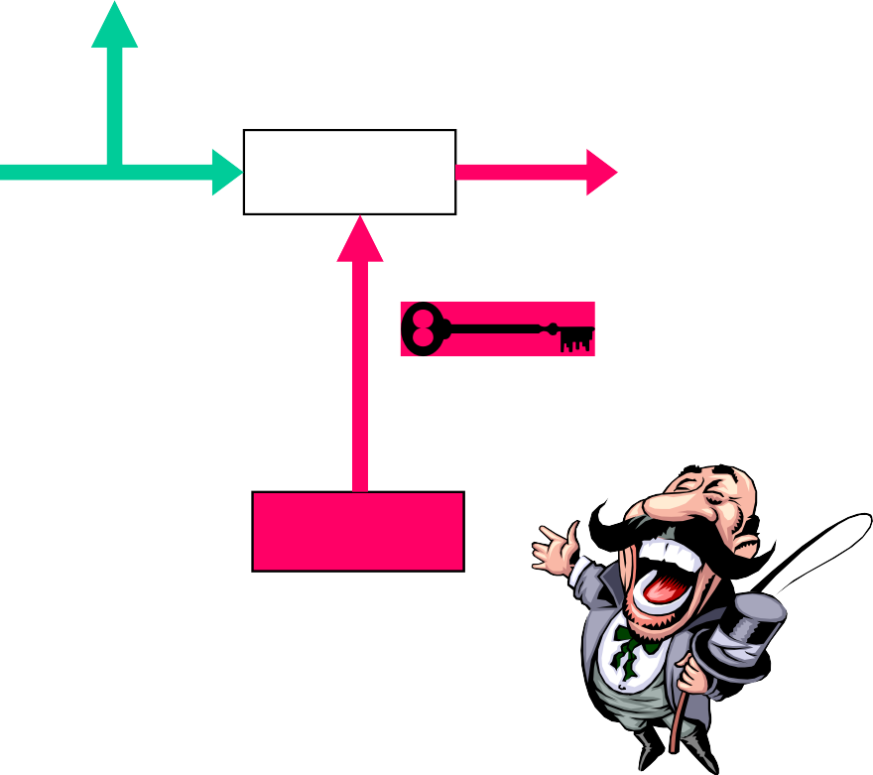


Asymmetric crypto system
Oscar
Alice
Encryptor
Decryptor
Bob
d_{k}
Authentic channel
e_{k}
Key source

Slide 9
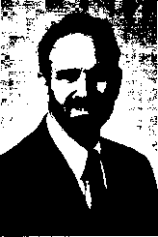
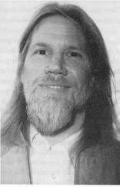
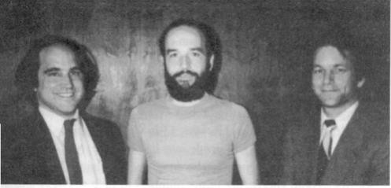
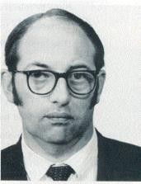
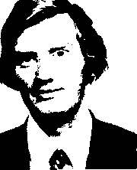
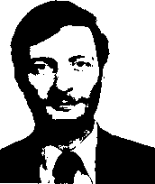
Public key inventors?
Marty Hellman and Whit Diffie, Stanford 1976
R. Rivest, A. Shamir and L. Adleman, MIT 1978 James Ellis, CESG 1970
C. Cocks, M. Williamson, CESG 1973-1974

Slide 10


Asymmetric crypto
Public key cryptography was born in May 1975, the child of two problems and a misunderstanding!
Trap-door one-way functions
Key Distribution!
Digital signing!

Slide 11
One-way functions
Modular power function
Given n = pq, where p and q are prime numbers. No
efficient algoritms to find p and q.
Chose a positive integer b and define f : Z_{n} → Z _{n}
f(x) = x^{b} mod n
Modular exponentiation
Given prime p, generator g and a modular power a = g^{x} (mod p). No
efficient algoritms to find x. f : Z _{p} → Z _{p}
f(x) = g^{x} mod p

Slide 12


Diffie-Hellman key agreement (key exchange)
(provides no authentication)
Alice picks random integer a
Bob picks random integer b
gª mod p
g^{b} mod p
Computationally impossible to compute discrete logarithm
Alice computes the shared
secret
(g^{b})ª = g^{ab} mod p
Bob computes the same secret
(gª)^{b} = g^{ab} mod p.

Slide 13
Example
Z₁₁ using g = 2:
– 2¹ = 2 (mod 11)
– 2² = 4 (mod 11)
– 2³ = 8 (mod 11)
– 2⁴ = 5 (mod 11)
2⁶ = 9 (mod 11)
2⁷ = 7 (mod 11)
2⁸ = 3 (mod 11)
2⁹ = 6 (mod 11)
– 2⁵ = 10 (mod 11) 2¹⁰ = 1 (mod 11)
log₂ 5 = 4
log₂ 7 = 7
log₂ 1 = 10 (≡ 0 mod 10)

Slide 14
Example (2)
p = 3019662633453665226674644411185277127204721722044543980521881984280643980698016315342127777985323
7655786915947633907457862442472144616346714598423225826077976000905549946633556169688641786953396
0040623713995997295449774004045416733136225768251717475634638402409117911722715606961870076297223
4159137526583857970362142317237148068590959528891803802119028293828368386437223302582405986762635
8694772029533769528178666567879514981999272674689885986300092124730492599541021908208672727813714
8522572014844749083522090193190746907275606521624184144352256368927493398678089550310568789287558
75522700141844883356351776833964003
g = 1721484410294542720413651217788953849637988183467987659847411571496616170507302662812929883501017
4348250308006877834103702727269721499966768323290540216992770986728538508742382941595672248624817
9949179397494476750553747868409726540440305778460006450549504248776668609868201521098873552043631
7965394509849072406890541468179263651065250794610243485216627272170663501147422628994581789339082
7991578201408649196984764863302981052471409215846871176739109049866118609117954454512573209668379
5760420560620966283259002319100903253019113331521813948039086102149370446134117406508009893347295
86051242347771056691010439032429058
Finn a når gª (mod p) =
4411321635506521515968448863968324914909246042765028824594289876687657182492169027666262097915382
0952830455103982849705054980427000258241321067445164291945709875449674237106754516103276658256727
2413603372376920980338976048557155564281928533840136742732489850550648761094630053148353906425838
5317698361559907392252360968934338558269603389519179121915049733353702083721856421988041492207985
6566434665604898681669845852964624047443239120501341277499692338517113201830210812184500672101247
2700988032756016626566167579963223042395414267579262222147625965023052419869061244027798941410432
6855174387813098860607831088110617

Slide 15
Solution
a = 71893136149709653804503478677866573695060790720621260648699193249561437588126371185
81694154929099396752251787268346548051895320171079663652680741564200286881487888963
19895353311170236034836658449187117723820644855184055305945501710227615558093657781
93109639893698220411548578601884177129022057550866690223052160523604836233675971504
25938247630127368253363295292024736143937779912318142315499711747531882501424082252
28164641111954587558230112140813226698098654739025636607106425212812421038155501562
37005192231836155067262308141154795194735834753570104459663325337960304941906119476
18181858300094662765895526963615406
It is easy to compute gª (mod p) {0.016 s}, but it is computaionally infeasable to compute the exponent a from the gª.

Slide 16
Diffie-Hellman Applications
IPSec (IP Security):
IKE (Internet Key Exchange) is part of the IPSec
protocol suite.
IKE is based on Diffie-Hellman Key Agreement.
SSL/TLS:
Several variations of SSL/TLS protocol including:
Fixed Diffie-Hellman.
Ephemeral Diffie-Hellman.
Anonymous Diffie-Hellman.

Slide 17
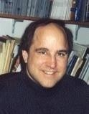
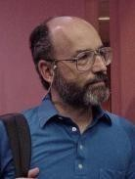
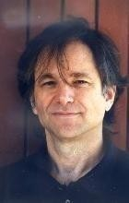
Ron Rivest, Adi Shamir and Len Adleman
Read about public-key cryptography in 1976 article by Diffie & Hellman: “New directions in cryptography”.
Intrigued, they worked on finding a practical algorithm.
Spent several months in 1976 to re-invent the method for non-secret/public-key encryption discovered by Clifford Cocks 3 years earlier.
Named RSA algorithm.

Slide 18
RSA parametre (textbook version)
Bob generates two large prime numbers p and q and computes n =
p·q.
He then computes a public encryption exponent e, such that
(e, (p-1)(q-1)) ) = 1 and computes the corresponding decryption
exsponent d, by solving:
d·e ≡ 1 (mod (p-1)(q-1) )
Bob’s public key is the pair P_{B} = (e, n) and the corresponding private
and secret key is S_{B} = (d, n).
Encryption: C = Me (mod n) Decryption: M = C^{d} (mod n)

Slide 19
RSA toy example
Set p = 157, q = 223. Then n = p·q =157 · 223 = 35011 and
(p-1)(q-1) = 156 ·222 = 34632
Set encryption exponent: e = 14213 {gcd(34632,14213) = 1}
Public key: (14213, 35011)
Compute: d = e ⁻¹ = 14213 ⁻¹ (mod 34632) = 31613
Private key: (31613, 35011)
Encryption:
Plaintext M = 19726, then C = 19726¹⁴²¹³ (mod 35011) = 32986
Decryption:
Cipherertext C = 32986, then M = 32986³¹⁶¹³(mod 35011) = 19726

Slide 20
Factoring record– December 2009
Find the product of
p = 33478071698956898786044169848212690817704794983713768568
912431388982883793878002287614711652531743087737814467999489
and
q= 367460436667995904282446337996279526322791581643430876426
76032283815739666511279233373417143396810270092798736308917?
Answer:
n= 123018668453011775513049495838496272077285356959533479219732
245215172640050726365751874520219978646938995647494277406384592
519255732630345373154826850791702612214291346167042921431160222
1240479274737794080665351419597459856902143413
Computation time ca. 0.0000003 s on a fast laptop!
RSA768 - Largest RSA-modulus that have been factored (12/12-2009) Up to 2007 there was 50 000$ prize money for this factorisation!

Slide 21
Computational effort?
Factoring using NFS-algorithm (Number Field Sieve).
6 mnd using 80 cores to find suitable polynomial.
Solding from August 2007 to April 2009 (1500 AMD64-år).
192 796 550 * 192 795 550 matrise (105 GB).
119 days on 8 different clusters.
Corresponds to 2000 years processing on one single core 2.2GHz AMD Opteron (ca. 2⁶⁷ instructions).

Slide 22
Asymmetric Ciphers: Examples of Cryptosystems:
RSA: best known asymmetric algorithm.
RSA = Rivest, Shamir, and Adleman (published 1977).
Historical Note: U.K. cryptographer Clifford Cocks invented the same algorithm in 1973, but didn’t publish.
ElGamal Cryptosystem:
Based on the difficulty of solving the discrete log problem.
Elliptic Curve Cryptography:
Based on the difficulty of solving the EC discrete log problem.
Provides same level of security with smaller key sizes.

Slide 23

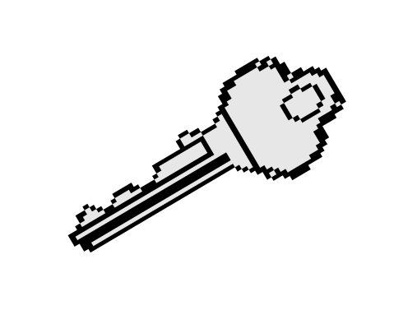
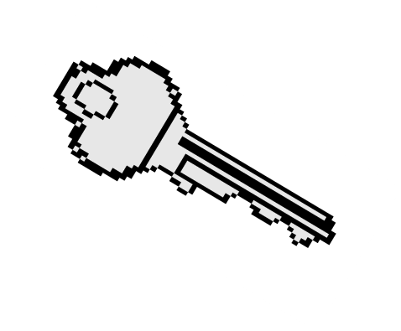
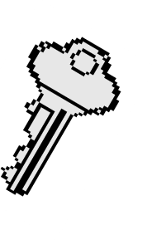

Asymmetric Encryption: Basic encryption operation
In practice, large messages are not encrypted directly with asymmetric algorithms. Hybrid systems are used, where only symmetric session key is encrypted with asymmetric alg.
Bob’s
private key
Bob
Alice
Plaintext M
ciphertext
plaintext
Encryption Operation
Decryption Operation
Alice’s public key ring
C = E(M,K_{pub})
M = D(C,K_{priv})
Bob’s public key
74

Slide 24
Hybrid Cryptosystems
Symmetric ciphers are faster than asymmetric ciphers (because they are less computationally expensive ), but ...
Asymmetric ciphers simplify key distribution, therefore ...
a combination of both symmetric and asymmetric ciphers can be used – a hybrid system:
The asymmetric cipher is used to distribute a randomly chosen symmetric key.
The symmetric cipher is used for encrypting bulk data.
75

Slide 25

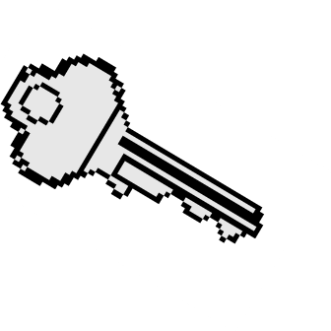
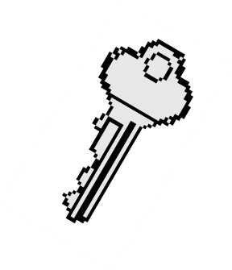
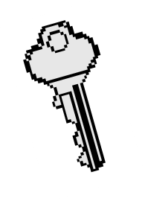

Confidentiality Services: Hybrid Cryptosystems
Alice’s public key ring
Bob’s public key
Bob’s private key
K - Random
symmetric key
Encrypted K _{Decryption}
Operation
Encryption
Operation
K - Random symmetric key
Alice
Bob
Encryption Operation
Ciphertext C
Decryption Operation
Plaintext M
C = E(M,K)
M = D(C,K)
Plaintext
M
76

Slide 26
Digital Signatures
26

Slide 27
Digital Signature Mechanisms
A MAC cannot be used as evidence that should be verified by a third party.
Digital signatures used for non-repudiation, data origin authentication and data integrity services, and in some authentication exchange mechanisms.
Digital signature mechanisms have three components:
key generation.
signing procedure (private).
verification procedure (public).
Algorithms:
RSA.
DSA and ECDSA.
27

Slide 28


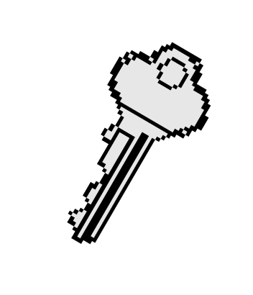


Practical digital signature based on hash value
Alice’s private key
Bob’s
public key Bob
ring
Alice’s public key
Alice
Digital Signature
Sign hashed message
Recover hash from Sig
h(M) = E(Sig,K_{pub})
Sig = D(h(M),K_{priv})
Compute hash h(M)
Verify h(M) = h(M’ )
Compute hash h(M’ )
Plaintext M
Received plaintext M’
28

Slide 29
Digital Signatures
To get an authentication service that links a document to A’s name (identity) and not just a verification key, we require a procedure for B to get an authentic copy of A’s public key.
Only then do we have a service that proves the authenticity of documents ‘signed by A’.
This can be provided by a PKI (Public Key Infrastructure).
Yet even such a service does not provide non- repudiation at the level of persons.
29

Slide 30

Difference between MACs & Dig. Sig.
MACs and digital signatures are both authentication mechanisms.
MAC: the verifier needs the secret that
?
was used to compute the MAC; thus a MAC is unsuitable as evidence with a third party.
The third party does not have the secret.
The third party cannot distinguish between the parties knowing the secret.
Digital signatures can be validated by third parties, and can in theory thereby support both non-repudiation and authentication.
☺
30

Slide 31
Key length comparison:
Symmetric and Asymmetric ciphers offering comparable security
AES Key Size | RSA Key Size | Elliptic curve Key Size
- | 1024 | 163
128 | 3072 | 256
192 | 7680 | 384
256 | 15360 | 512
31

Slide 32
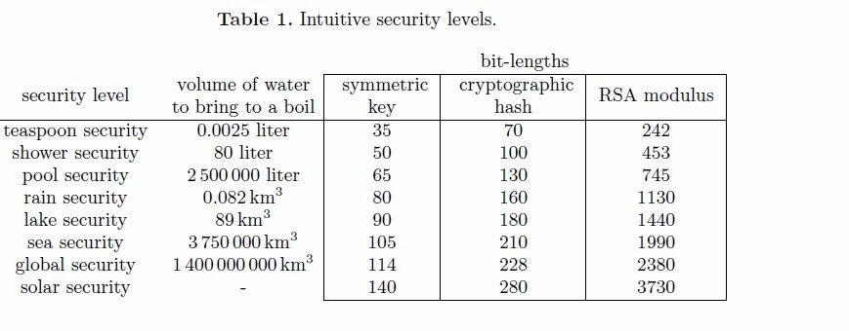
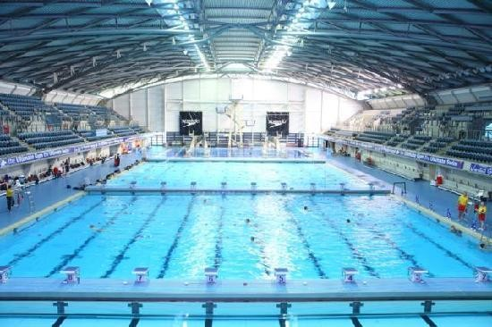
Another look at key lengths
32

Slide 33
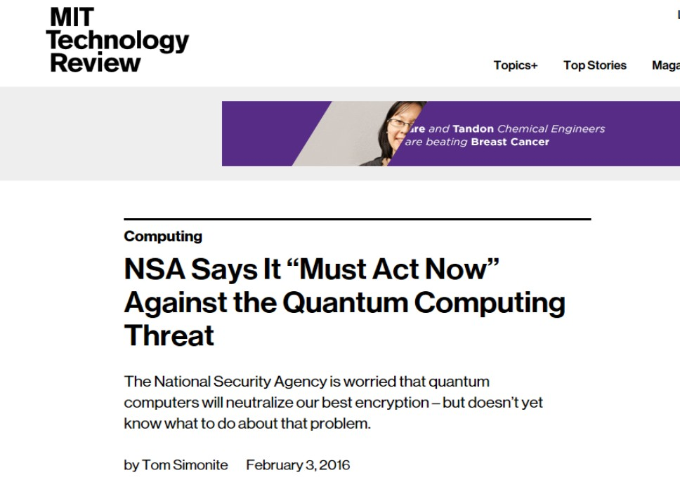
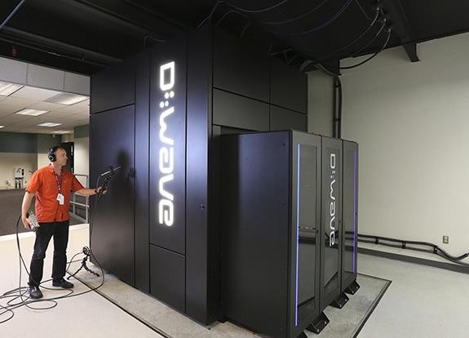

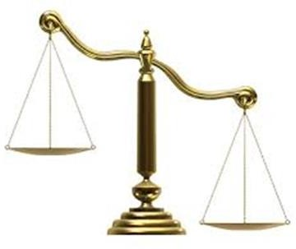
The eavesdropper strikes back!
33

Slide 34
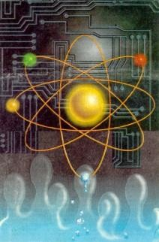
Quantum Computers
Proposed by Richard Feynman 1982.
Boosted by P. Schor’s algorithm for integer factorization and discrete logarithm in quantum polynomial time.
Operates on qubit – superposition of 0 and 1.
IBM built a 7-bit quantum computer and could find the factors of the integer 15 using NMR techniques in 2001.
NMR does not scale.
Progress continues, but nobody knows if or when a large scale quantum computer ever can be constructed.
QC will kill current public key techniques, but does not mean an end to symmetric crypto.
34

Slide 35
QC impact to cryptography
When will a quantum computer be built?
–15 years, $1 billion USD, nuclear power plant (PQCrypto
2014, Matteo Mariantoni)
Impact:
–Public key crypto:
RSA
Elliptic Curve Cryptography (ECDSA)
Finite Field Cryptography (DSA)
Diffie-Hellman key exchange
–Symmetric key crypto:
AES Need larger keys
Triple DES Need larger keys
–Hash functions:
SHA-1, SHA-2 and SHA-3 Use longer output
35

Slide 36
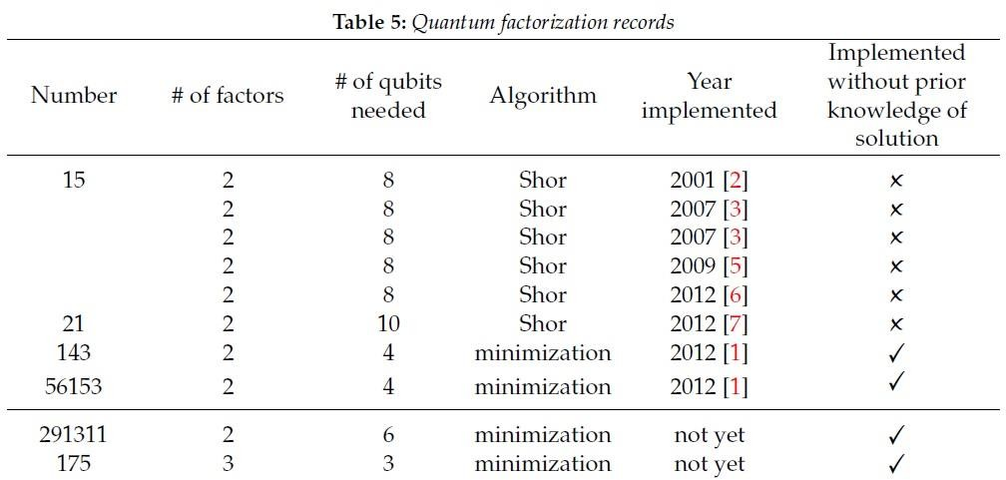
Current world record of QF!
https://phys.org/news/2014-11-largest-factored-quantum-device.html
36

Slide 37
Two variants of quantum safe crypto
Quantum cryptography:
The use of quantum mechanics to guarantee secure communication.
It enables two parties to produce a shared random secret key known only to them, which can then be used to encrypt and decrypt messages.
Quantum resistant cryptography:
The use of cryptographic mechanisms based on computationally difficult problems for which no efficient quantum computing algorithm is known
37

Slide 38
Quantum Resistant Cryptography
Code Based Asymmetric Algorithms.
Lattice Based Asymmetric Algorithms.
Asymmetric Crypto based on Multivariate Polynomials.
Asymmetric Crypto based on Cryptographic Hash Functions.
Asymmetric Crypto based on Isogenies of (supersingular) elliptic curves.
05-Feb-18
Introduction to Cryptography - Part 6
38

Slide 39
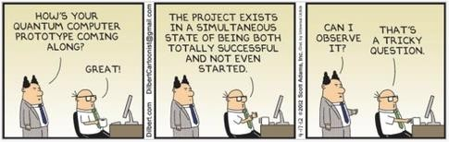
Brave new crypto world……………
39

Slide 40
End of lecture
40

